Slide 1

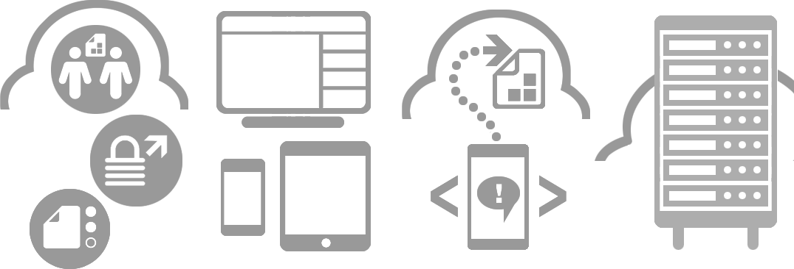








Project Manager scenario with Point.io web console
Julien Gaye
Sales Engineer
+44 7708 147 445
jgaye@point.io

Slide 2
Project Manager scenario
The Project Manager selects the documents, users and users rights for the project he is creating. His goal is to grant the right accesses to the right persons for its project, while minimizing the enterprise storage exposure.
Access Rules and everything related to Hubs are managed by the Project Manager. In the web console, a hub represents a project.
In the next slide,
Blue component are available in the current web console
Red components don’t exist in Point.io technology

Slide 3
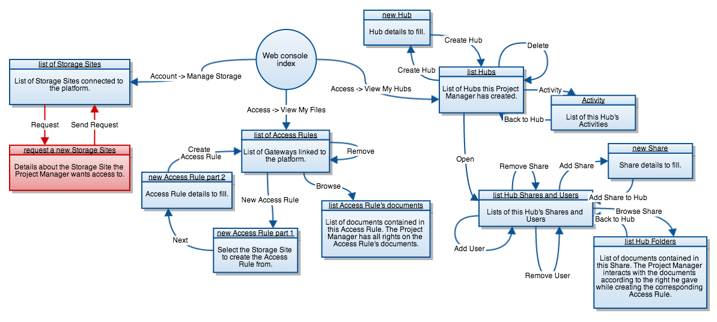
Click a shape to access its description directly.

Slide 4
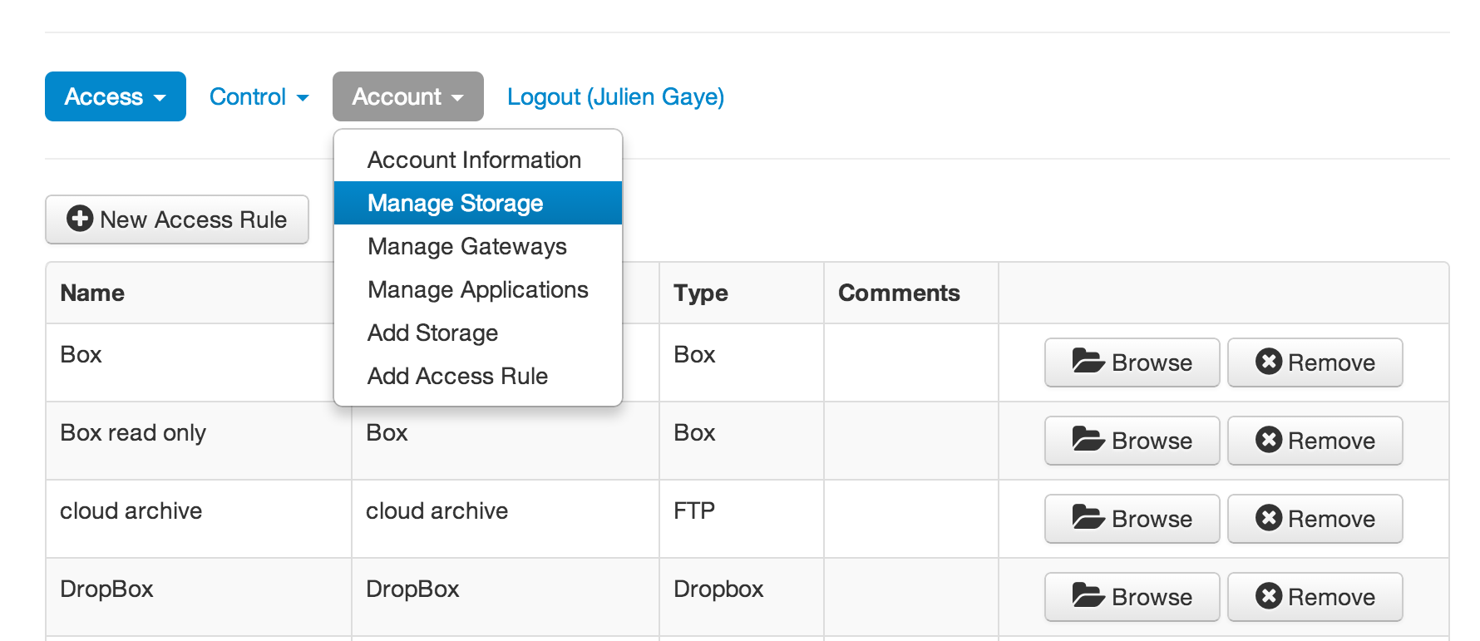
A Storage Site is the representation of an access to a storage location inside the enterprise’s network.
The Project Manager can see the Storage Sites authorized by the Storage Administrator by going to Account -> Manage Storage.

Slide 5
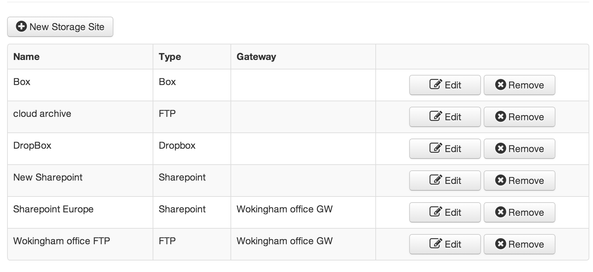
The Storage Sites page displays the list of usable Storage Sites.
Each entry shows a Name, a Storage Type and the Name of the Gateway used for this connection.
The Project Manager can’t use the Edit and Remove options.
A “Request for a new Storage Site” option for the Project Manager should be available for this use case.

Slide 6
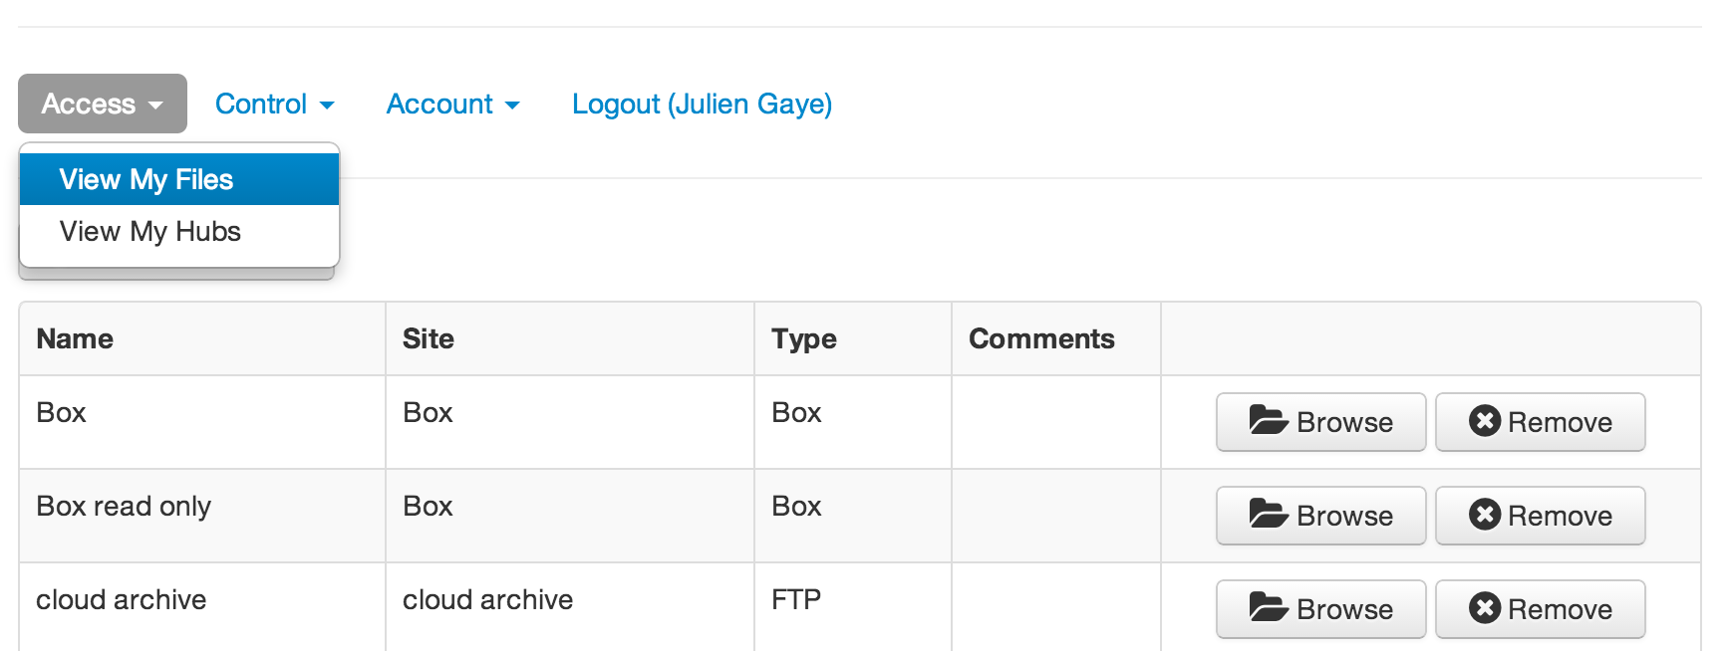
An Access Rule is a right management layer that sit on top of a Storage Site to limit the users interactions with a storage location’s documents. The Project Manager creates them and use them in projects for document access.
The Access Rules management page is at Access -> View My Files.

Slide 7
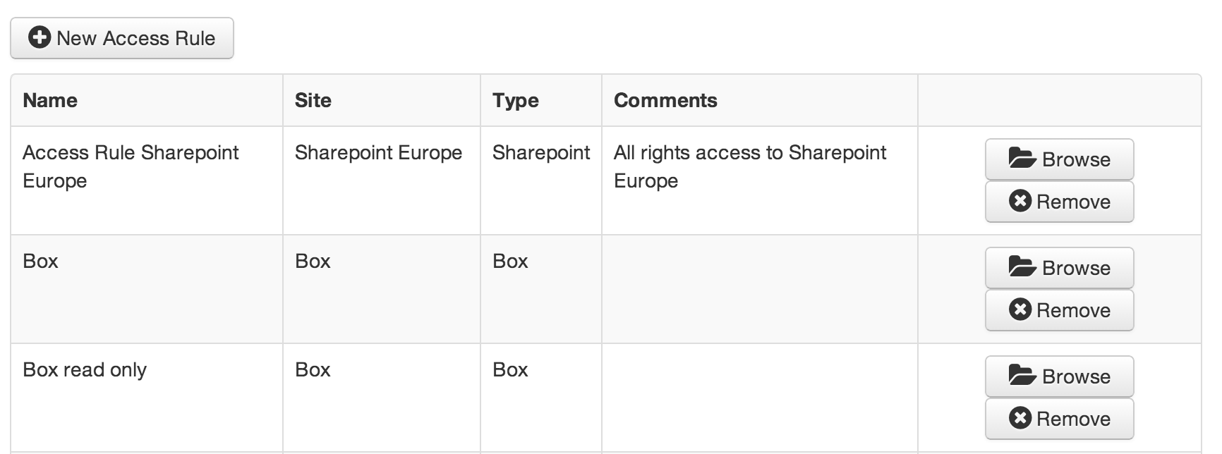
The Access Rules management page displays the list of Access Rules created by the Project Manager.
Each entry shows a Name, the Storage Site the Access Rules sits on top of, the type of this Storage Site, and Comments.
The Project Manager can remove a specific Access Rule, or browse its documents. The right management of the Access Rule doesn’t apply to the Project Manager when he browses it.
A new Access Rule can be created with the “New Access Rule” button.

Slide 8
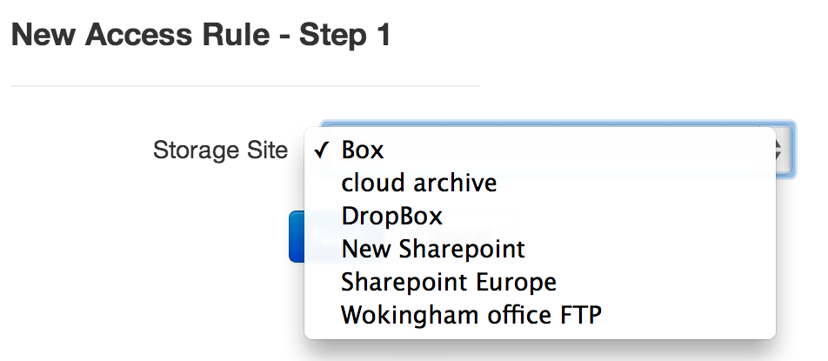
The creation of a new Access Rule consists of two steps.
For the first step, the Project Manager selects the existing Storage Site the Access Rule will be on top of from a dropdown.

Slide 9
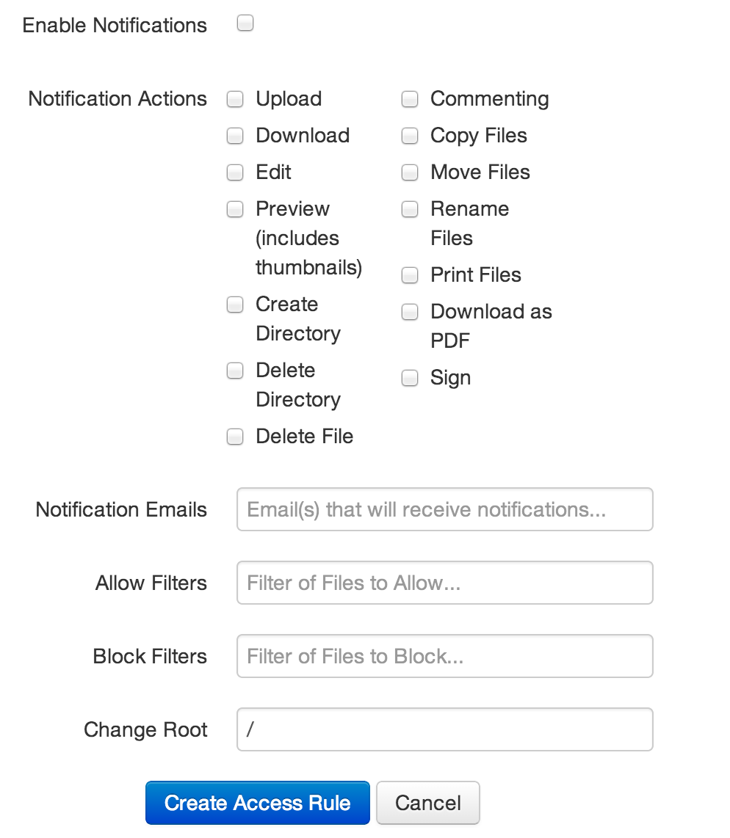
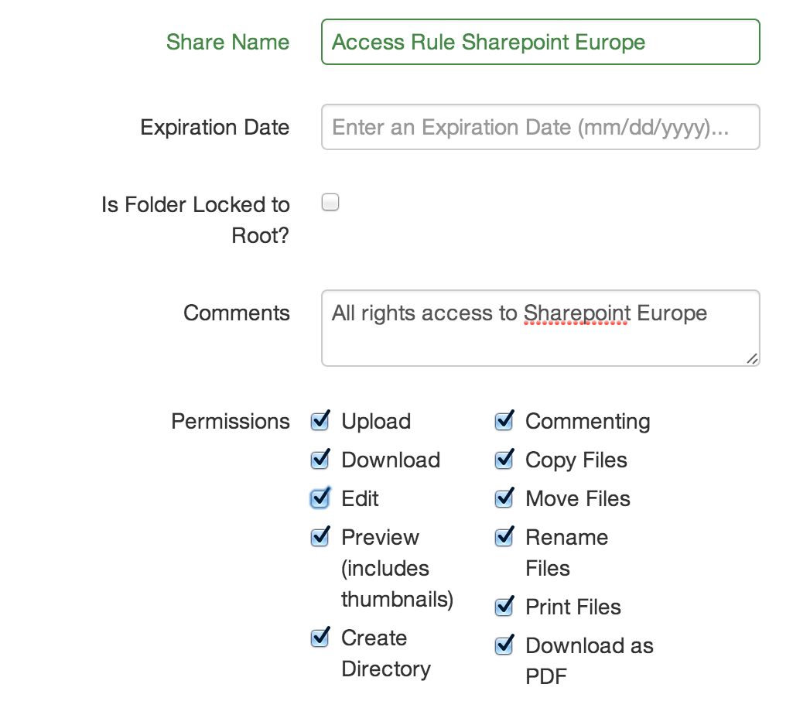
The second step consists in filling the new Access Rule’s details:
A Name by which it will be referred in the Access Rules list
An Expiration Date after which the Access Rule is automatically deleted. This field can be omitted.
A “Lock to root” option to prevent users to access the changed root’s parent folders.
A comment that will be displayed on the Access Rules list.
The list of permissions granted when accessing a Storage Site via this Access Rule.
A list of notification actions when users manipulate the documents
A Change Root, which is the path the user will start at when accessing a Storage Site via this Access rule.
Click “Create Access Rule” to finish the creation process.

Slide 10
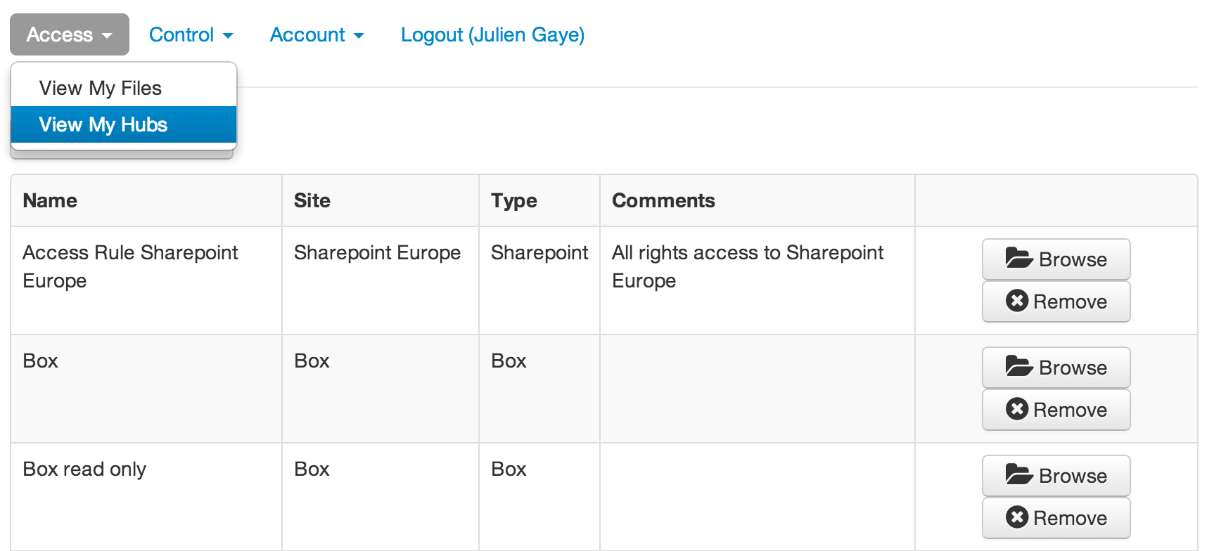
A project is represented by a Hub which is a virtual room where the Project Manager share all the relevant documents with all of the project’s members. The documents are accessed through Shares, that are selected by the Project Manager among the
Access Rules he has created.
The Hub management page is accessible through Access -> View My Hubs.

Slide 11
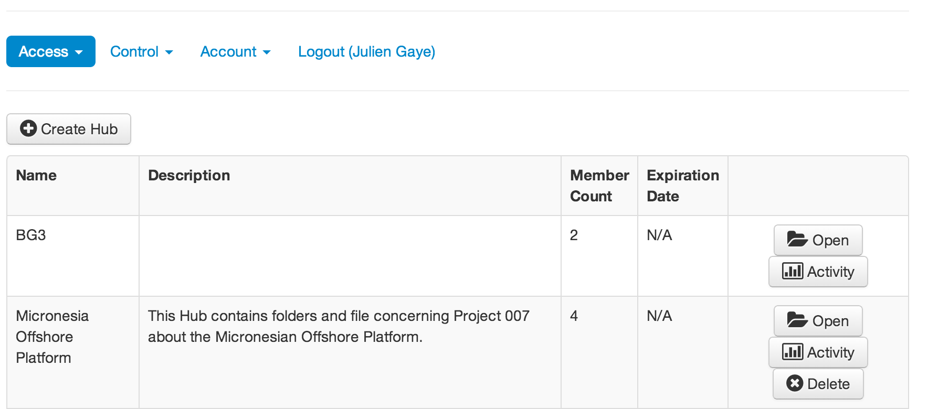
The list of Hubs the Project Manager has created is displayed. Each Hub entry shows a name, a description of the Hub, a count of its members, and an Expiration Date (if one has been set by the Project Manager). The Project Manager can create or delete a hub, open one to edit its Shares or list of members, and check the Activity of the users with this Hub.

Slide 12
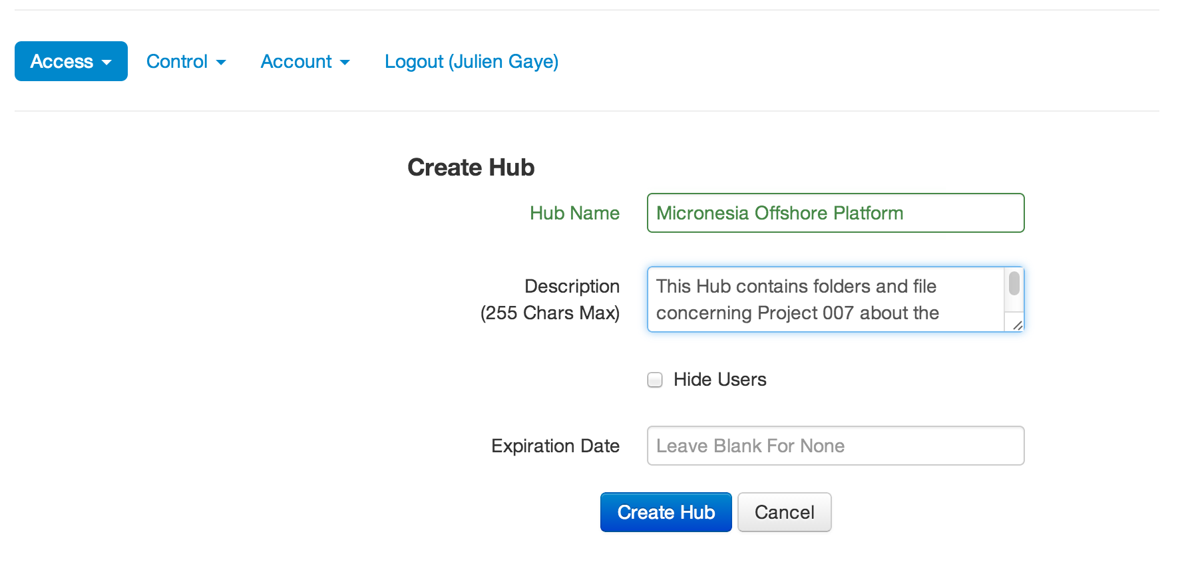
To create a Hub, the Project Manager has to fill the details of the new Hub with:
A Name that will be displayed in the Hubs list
A Description, displayed in the Hubs list as well
An option to hide the user list to the members of the Hub.
An Expiration Date after which the Hub will be automatically deleted. This field is optional.
To finish the creation, click “Create Hub”.

Slide 13
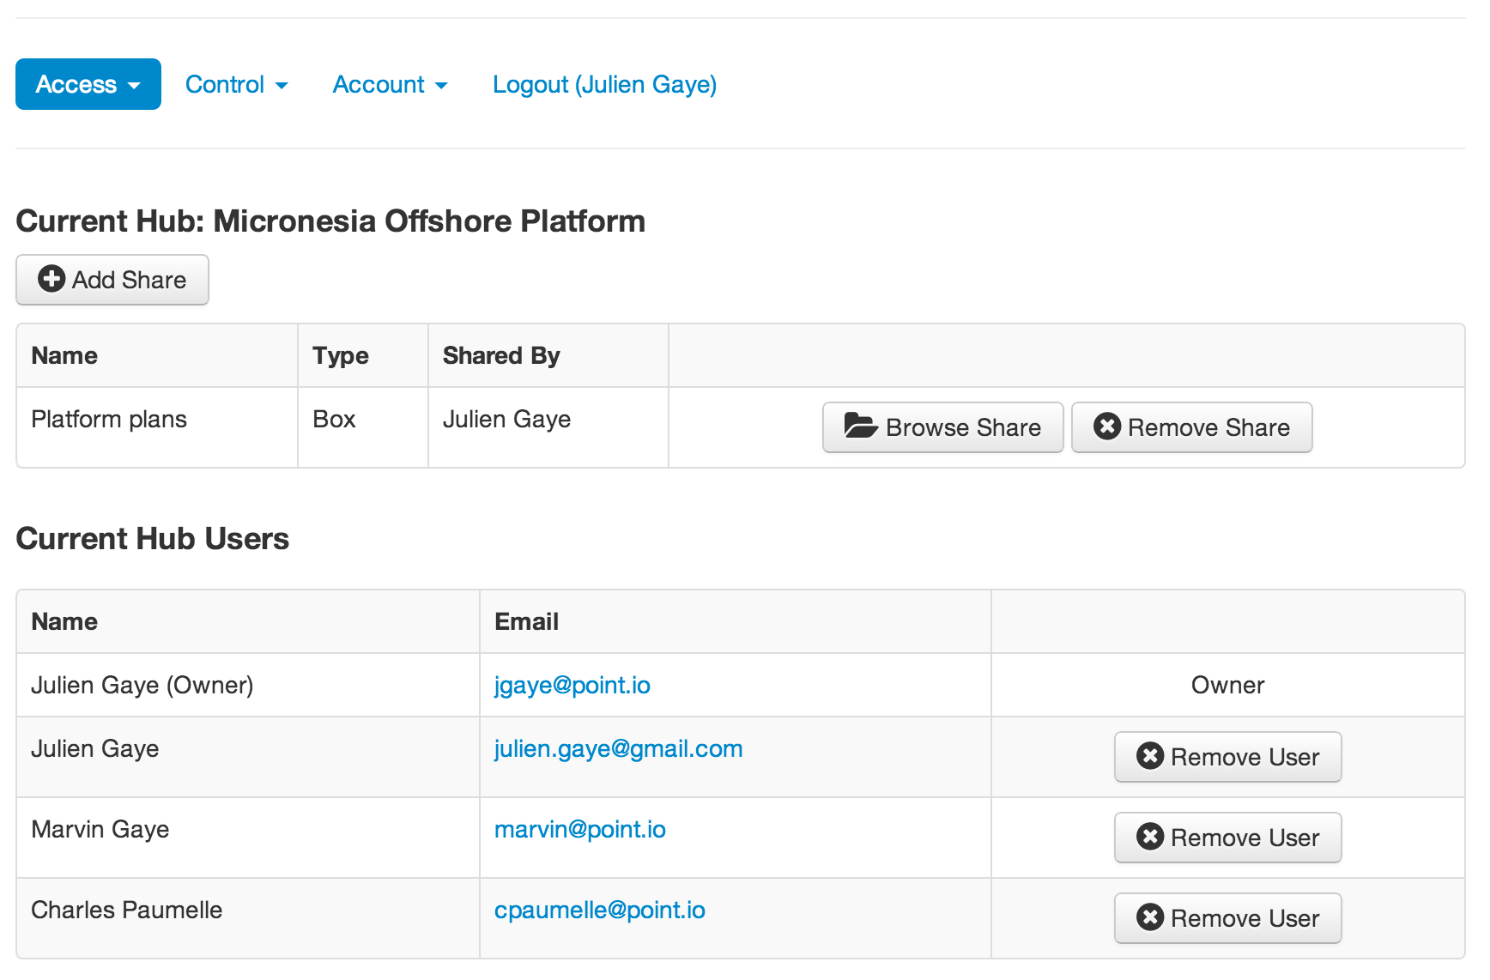
Opening a Hub gives the Project Manager the list of Shares and Members of this Hub.
Each Share is an Access Rule added by the Project Manager to the Hub, and shows a Name, the Storage Type and the name of the Project Manager who added it. The Project Manager can add or remove a Share, and Browse a specific Share.
The list of members contain the Name and Email of the users. The Project Manager can add or remove users from the Hub.

Slide 14
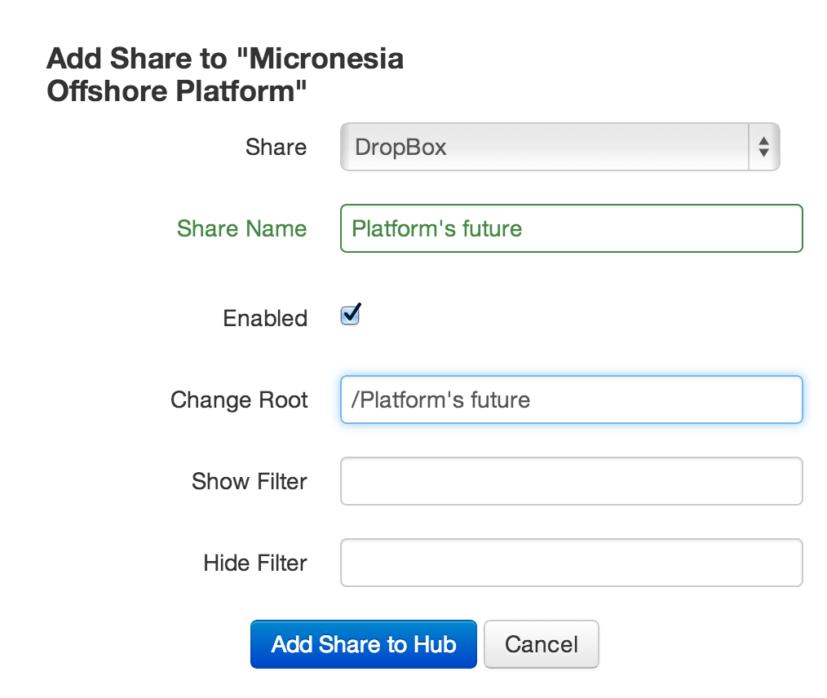
To add a Sahre, the Project Manager must fill the following details:
The Access Rule used for this Share. The Project Manager selects it from a dropdown
A name for the Sahre that will be displayed to all the users
A Change Root, which is the path the users will start at when browsing this Share.
Tick the “Enabled” option then “Add Share to Hub” to finish adding this Share.

Slide 15
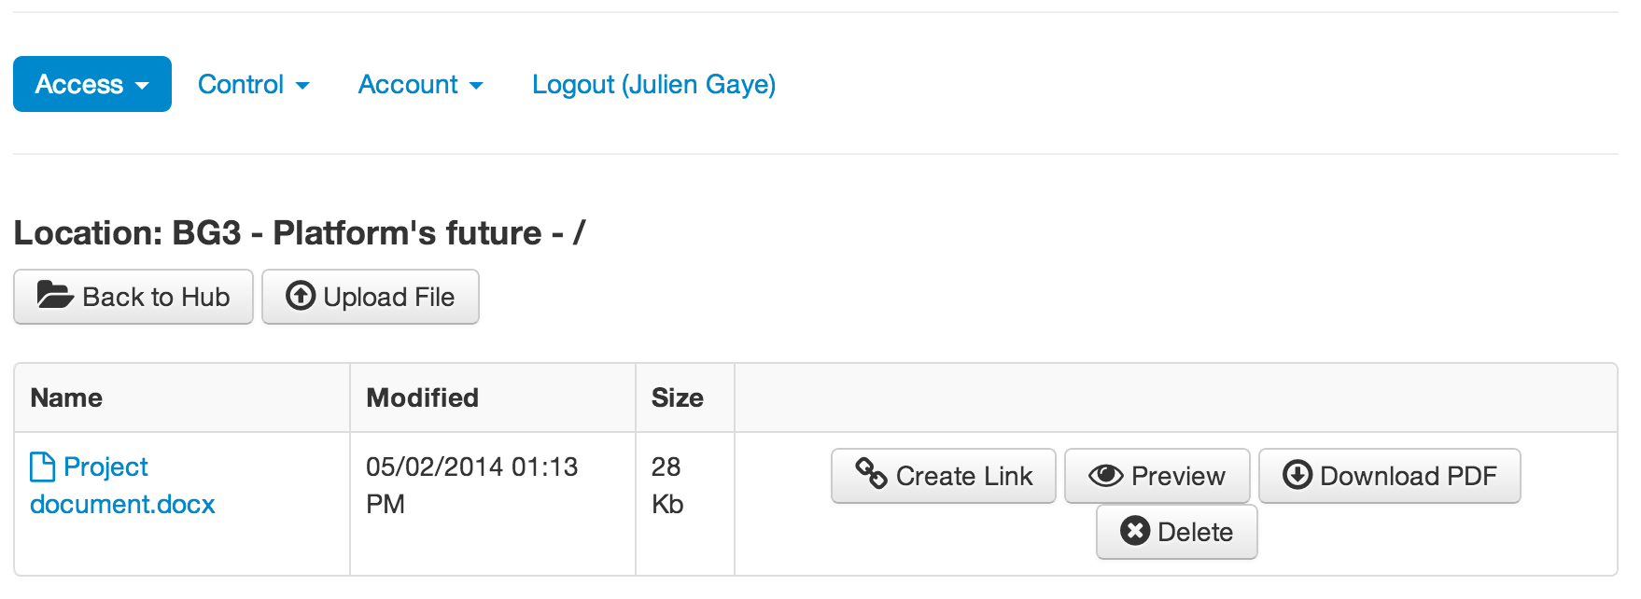
The documents contained in the Share are displayed to the Project Manager.
When browsing a Share, the Project Manager is subject to the right management system he put in place when creating the corresponding Access Rule.

Slide 16
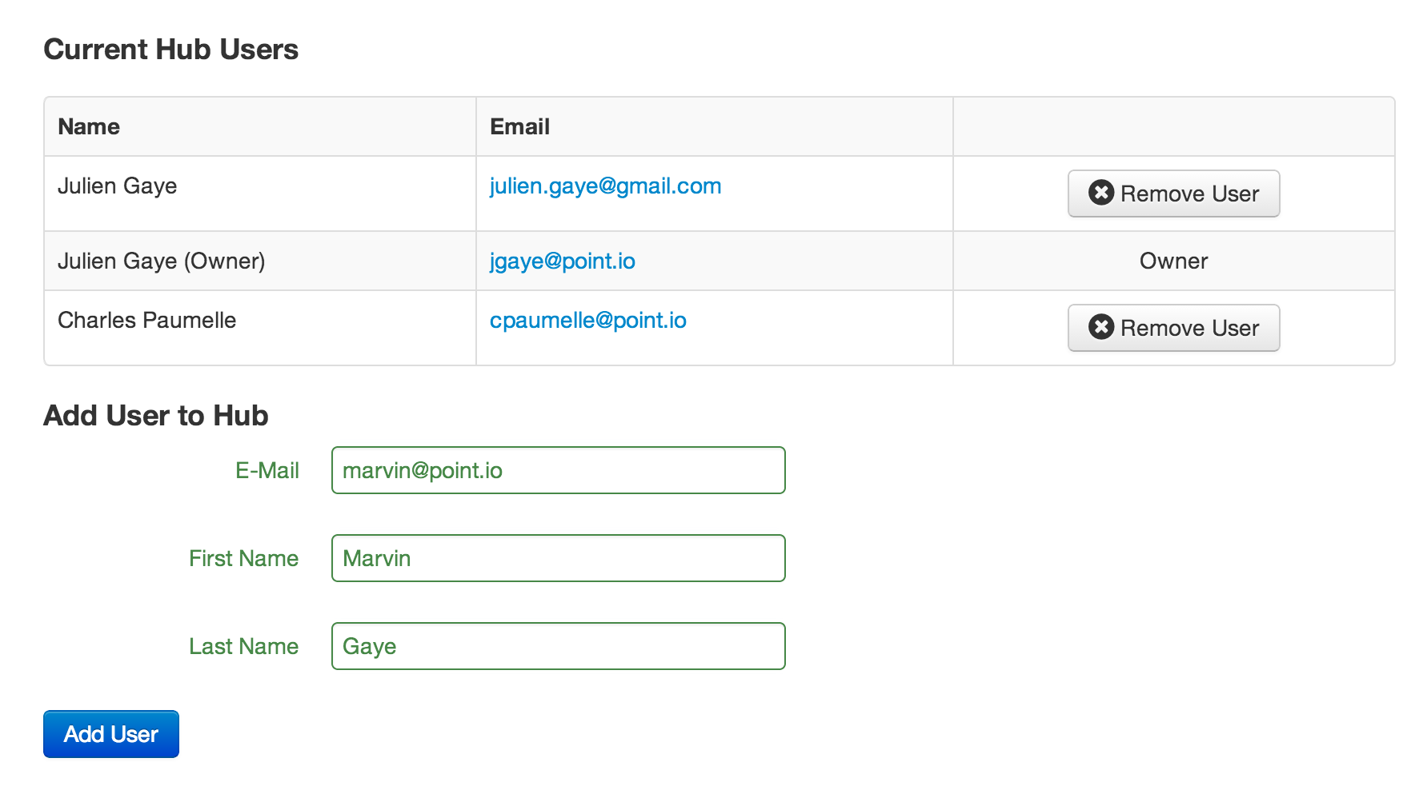
To add an user to the Hub, the Project Manager fill the details of the new user with the E-Mail address, the First Name and Last Name.
By clicking “Add User” an invitation is sent to this E-Mail address.

Slide 17
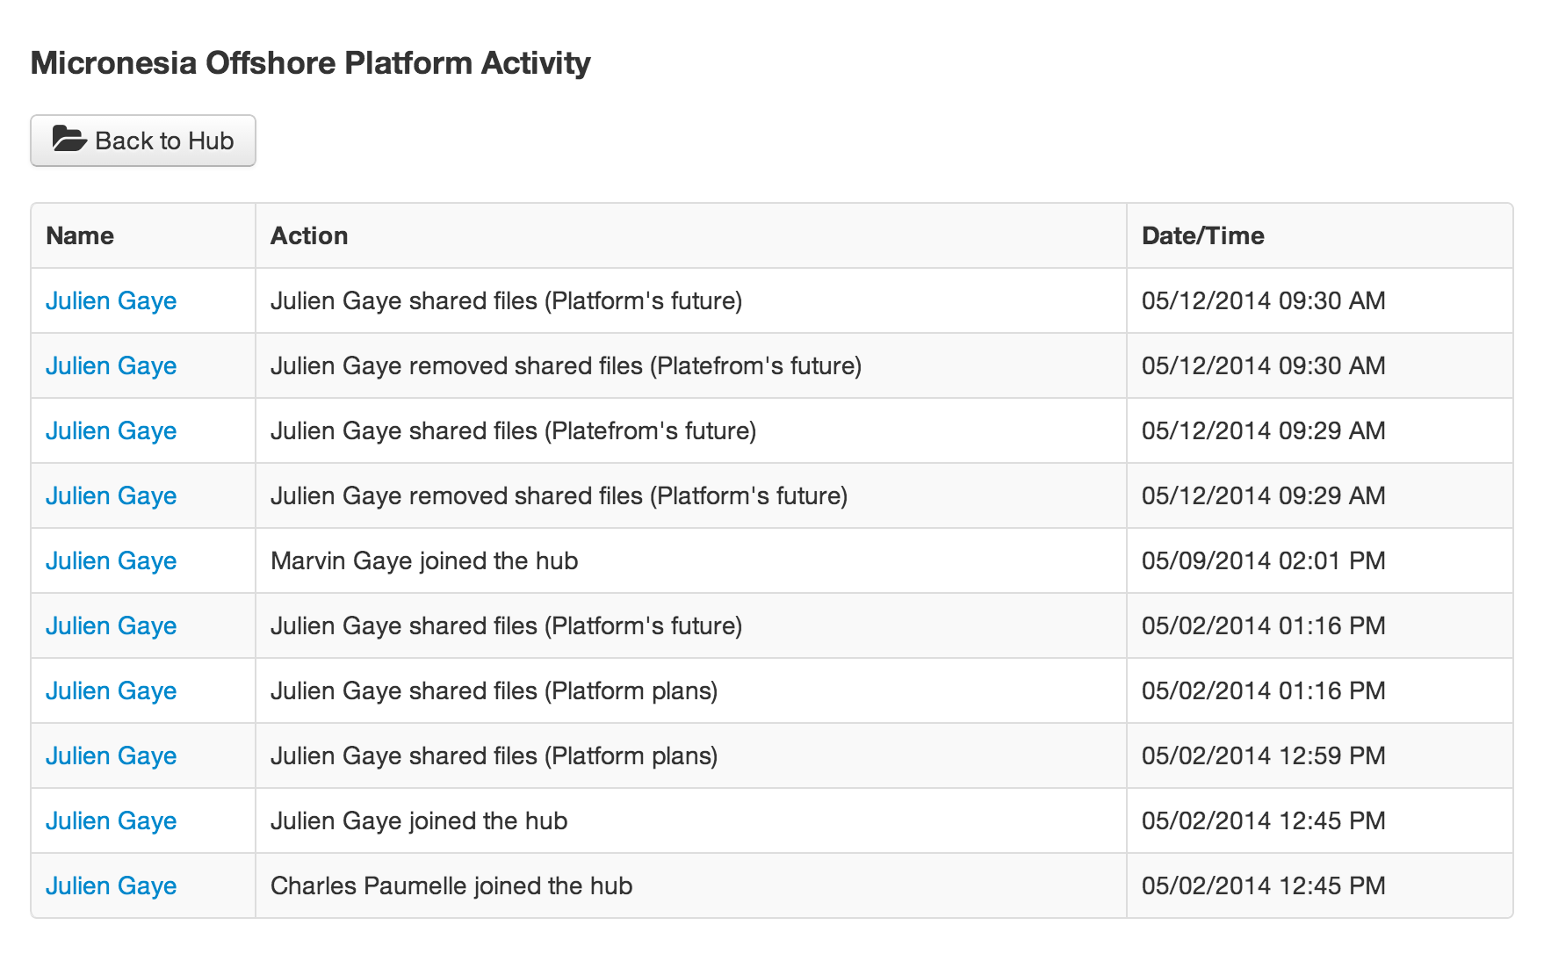
The Activity page of a Hub allows the Project Manager to monitor everything that has happened in the Hub.
The list of events produces by the users and the Project Manager isdisplayed.

